Slide 1
Distributed Operating Systems

Slide 2
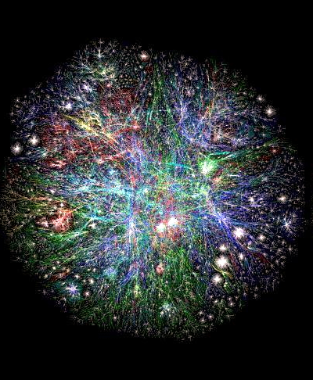
Examples of Distributed Systems
Transactional applications - Banking systems
Manufacturing and process control
Inventory systems
General purpose (university, office automation)
Communication – email, IM, VoIP, social networks
Distributed information systems
WWW
Cloud Computing Infrastructures
Federated and Distributed Databases

Slide 3
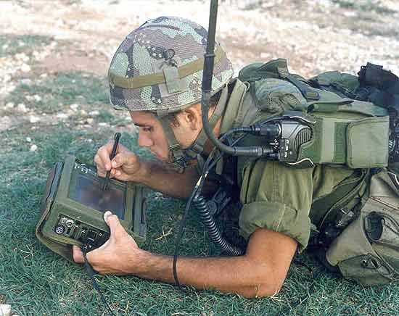
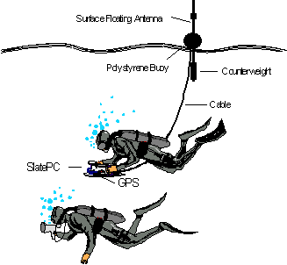
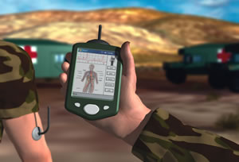
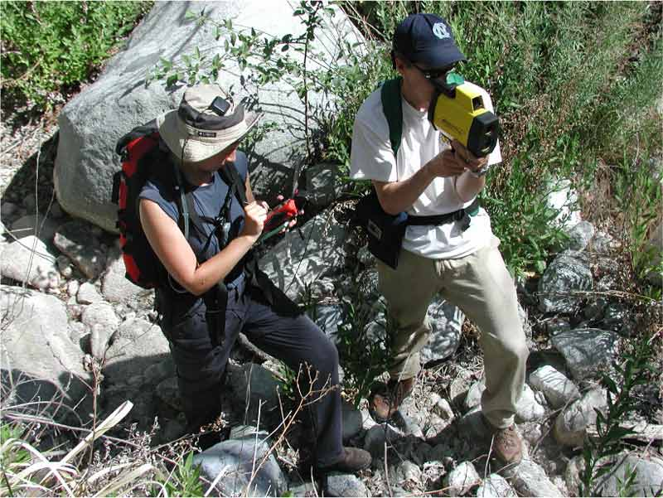
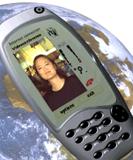
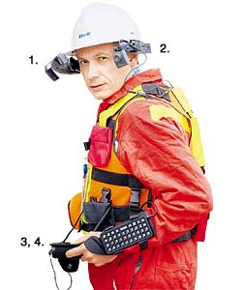

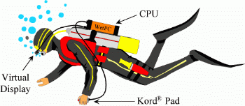
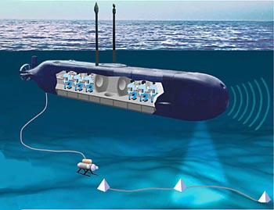
Mobile & ubiquitous distributed systems

Slide 4
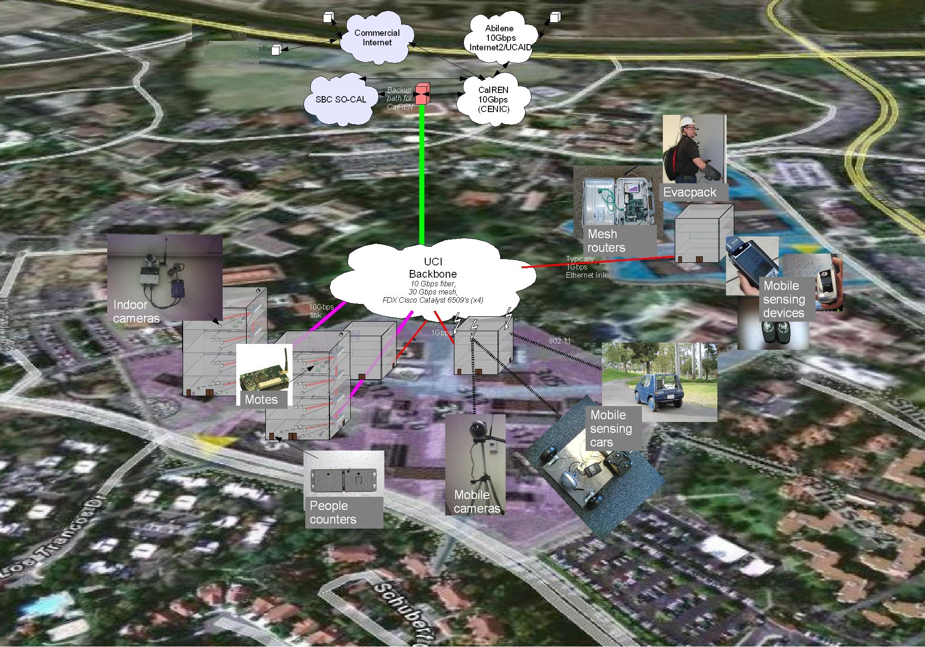

A Distributed CyberPhysical Space – UCI Responsphere
Campus-wide infrastructure to instrument, experiments, monitor, disaster drills & to validate technologies
sensing, communicating, storage & computing infrastructure
Software for real-time collection, analysis, and processing of sensor information
used to create real time information awareness & post-drill analysis
4

Slide 5
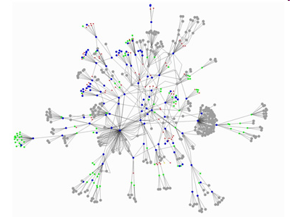
Peer to Peer Systems
P2P File Sharing
Napster, Gnutella, Kazaa, eDonkey, BitTorrent
Chord, CAN, Pastry/Tapestry, Kademlia
P2P Communications
MSN, Skype, Social Networking Apps
P2P Distributed Computing
Seti@home
Use the vast resources of machines at the edge of the Internet to build a network that allows resource sharing without any central authority.

Slide 6
Why Distributed Computing?
Inherent distribution
Bridge customers, suppliers, and companies at different sites.
Speedup - improved performance
Fault tolerance
Resource Sharing
Exploitation of special hardware
Scalability
Flexibility

Slide 7
Why are Distributed Systems Hard?
Scale
numeric, geographic, administrative
Loss of control over parts of the system
Unreliability of message passing
unreliable communication, insecure communication, costly communication
Failure
Parts of the system are down or inaccessible
Independent failure is desirable

Slide 8
Design goals of a distributed system
Sharing
HW, SW, services, applications
Openness(extensibility)
use of standard interfaces, advertise services, microkernels
Concurrency
compete vs. cooperate
Scalability
avoids centralization
Fault tolerance/availability
Transparency
location, migration, replication, failure, concurrency

Slide 9
Classifying Distributed Systems
Based on degree of synchrony
Synchronous
Asynchronous
Based on communication medium
Message Passing
Shared Memory
Fault model
Crash failures
Byzantine failures

Slide 10
Concurrency issues
Consider the requirements of transaction based systems
Atomicity - either all effects take place or none
Consistency - correctness of data
Isolated - as if there were one serial database
Durable - effects are not lost
General correctness of distributed computation
Safety
Liveness

Slide 11
Communication in Distributed Systems
Provide support for entities to communicate among themselves
Centralized (traditional) OS’s - local communication support
Distributed systems - communication across machine boundaries (WAN, LAN).
2 paradigms
Message Passing
Processes communicate by sharing messages
Distributed Shared Memory (DSM)
Communication through a virtual shared memory.

Slide 12
Reliability issues
Unreliable communication
Best effort, No ACK’s or retransmissions
Application programmer designs own reliability mechanism
Reliable communication
Different degrees of reliability
Processes have some guarantee that messages will be delivered.
Reliability mechanisms - ACKs, NACKs.

Slide 13
Remote Procedure Call
Builds on message passing
extend traditional procedure call to perform transfer of control and data across network
Easy to use - fits well with the client/server model.
Helps programmer focus on the application instead of the communication protocol.
Server is a collection of exported procedures on some shared resource
Variety of RPC semantics
“maybe call”
“at least once call”
“at most once call”

Slide 14
Other Distributed System issues
Concurrency and Synchronization
Distributed Deadlocks
Time in distributed systems
Naming
Replication
improve availability and performance
Migration
of processes and data
Security
eavesdropping, masquerading, message tampering, replaying

Slide 15
Distributed Systems Middleware
Middleware is the software between the application programs and the operating System and base networking
Integration Fabric that knits together applications, devices, systems software, data
Middleware provides a comprehensive set of higher-level distributed computing capabilities and a set of interfaces to access the capabilities of the system.

Slide 16


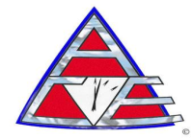









The Evergrowing Middleware Alphabet Soup
Distributed
Computing
Environment (DCE)‏
WS-BPEL
WSIL
WSDL
Java Transaction API (JTA)‏
Orbix
LDAP
JNDI
JMS
IOP
IIOP
GIOP
BPEL
BEA Tuxedo®
EAI
Object Request Broker
(ORB)‏
RTCORBA
SOAP
Message Queuing (MSMQ)‏
Distributed Component
Object Model (DCOM)
XQuery
XPath
opalORB
IDL
ZEN
Remote Method
Invocation
(RMI)‏
JINITM
Rendezvous
ORBlite
Encina/9000
Enterprise
JavaBeans
Technology
(EJB)‏
BEA WebLogic®
Remote Procedure Call
(RPC)‏
Extensible Markup Language (XML)‏
Borland® VisiBroker®

